Slide 1
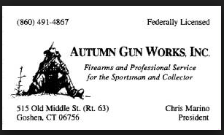
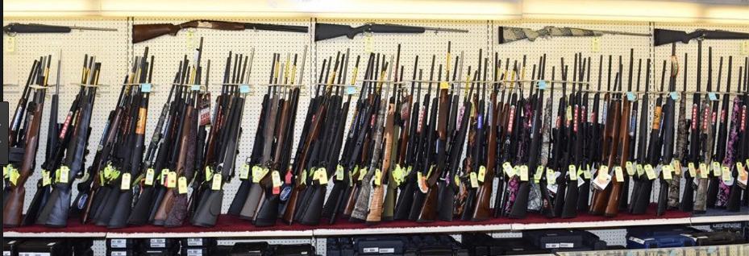
Team Autumn Gun Works INC
Process Model Improvement presentation
Date 04/26/2017
OPIM 5272: Business Process Modeling & Data Management

Slide 2
Agenda
Team Overview
Topic Introduction
Objective
Floor layout
Tables created
Run Queries
Conclusions
Q&A
Data Base/ERD
Process flow(Swim Lane)

Slide 3
Team Overview
Richard Coore
Tara
Chamberlain
Martin
Harisi
MBA/MPA, Education Data Analyst , Electrical Contracting
MSBAPM,
Manager Sales Operations
MBA/ MSBAPM , Product Development Engineer

Slide 4
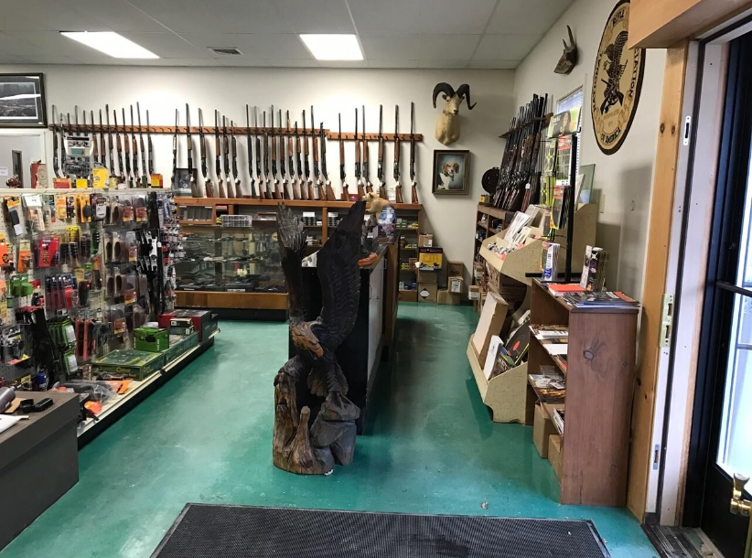

Topic Introduction
Small Gun Store and Repair based out of Goshen CT
Specialty in Gunsmith Services
Backlog in Repairs not managed efficiently
Team visit to Charter Arms Inc in Shelton to view processes

Slide 5

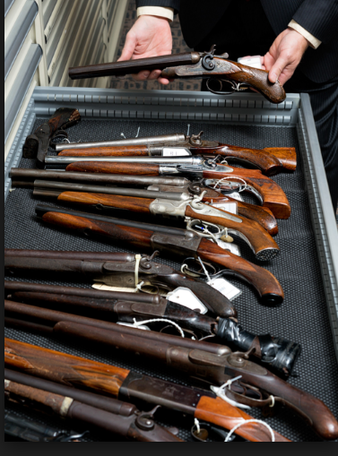
Objective
Create a database to help track job status, parts ordered, and store item location
Increase process efficiency for repair process

Slide 6
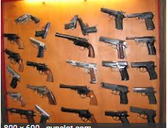
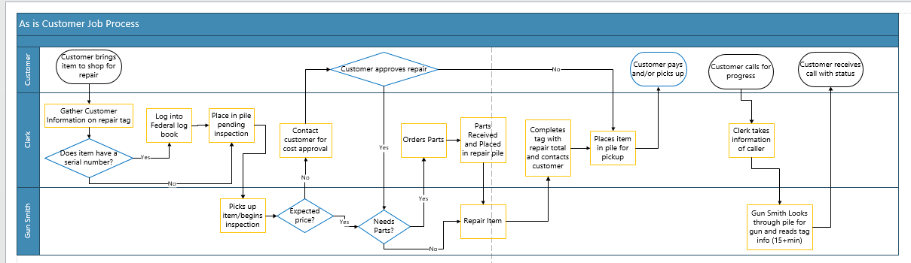
Process Flow “As is”

Slide 7
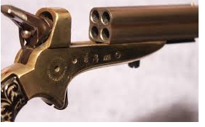
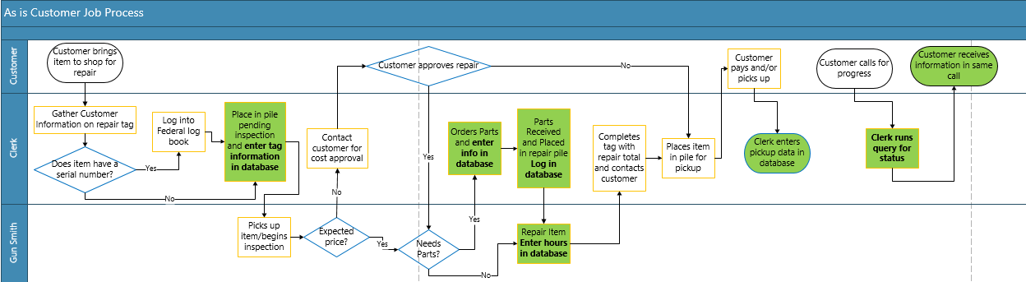
Process Flow “To be”

Slide 8
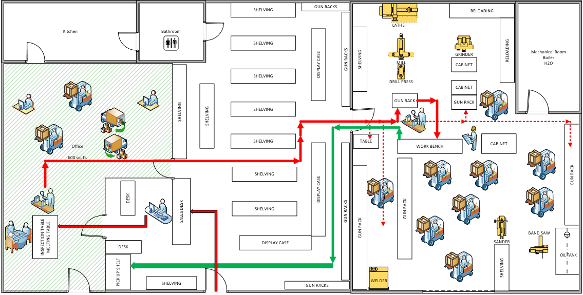
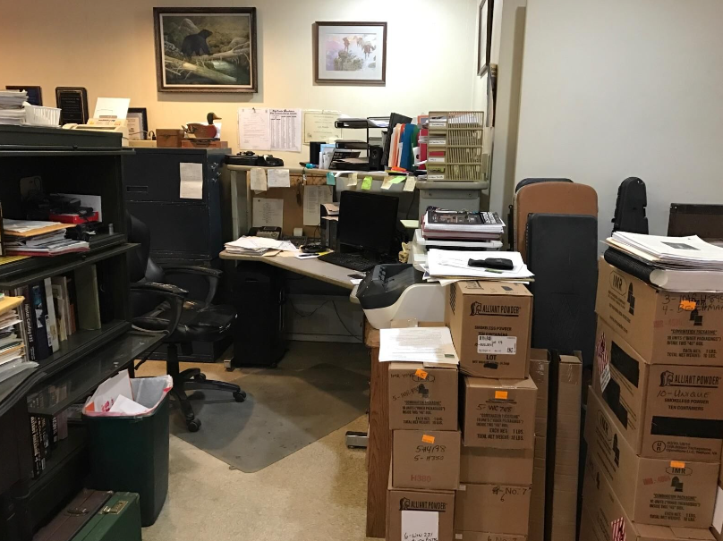
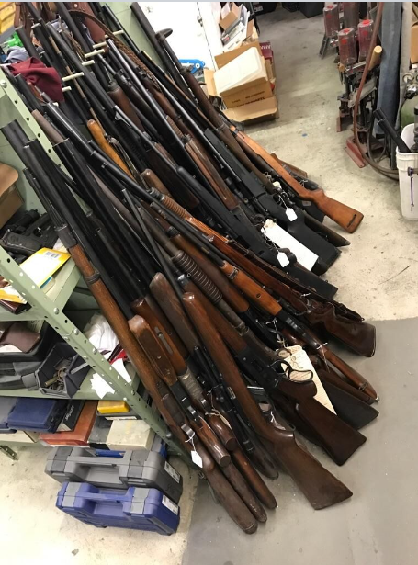
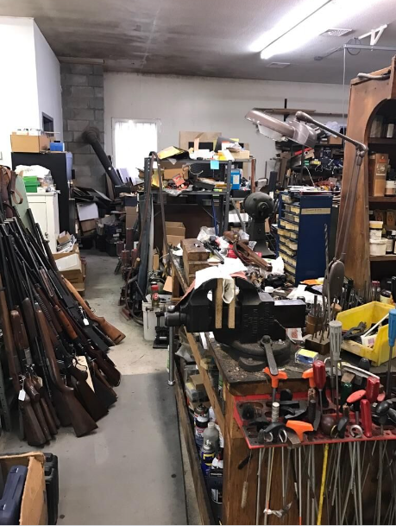
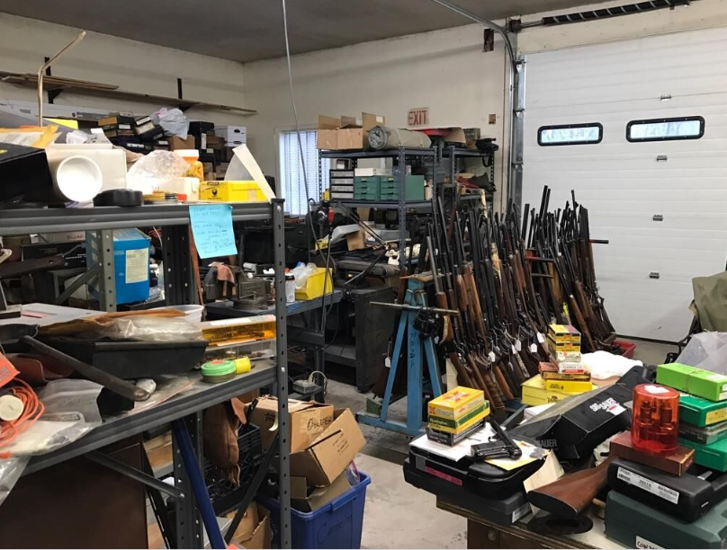
Floor Layout “As is”

Slide 9



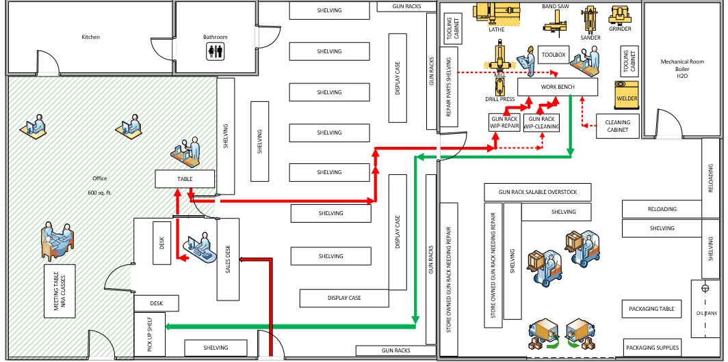
Floor Layout “To be”

Slide 10
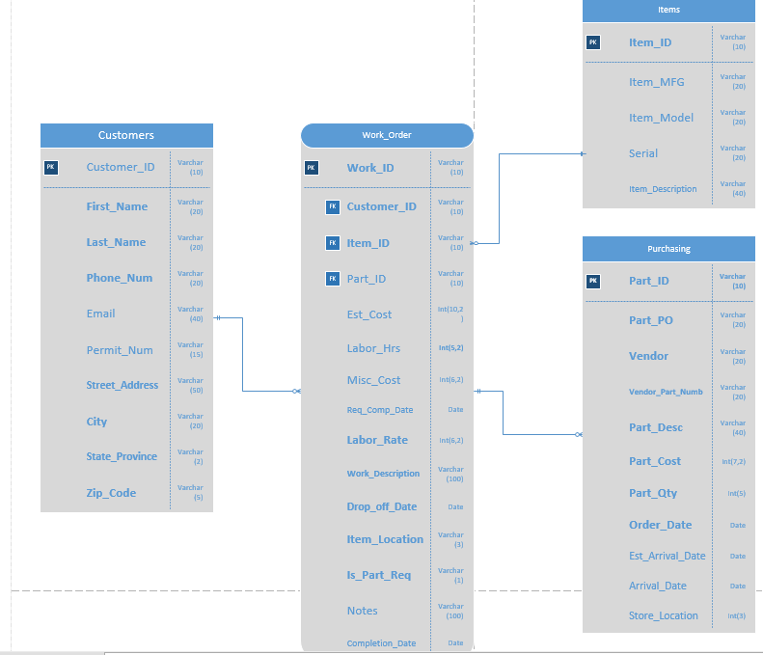
Data Base / ERD

Slide 11
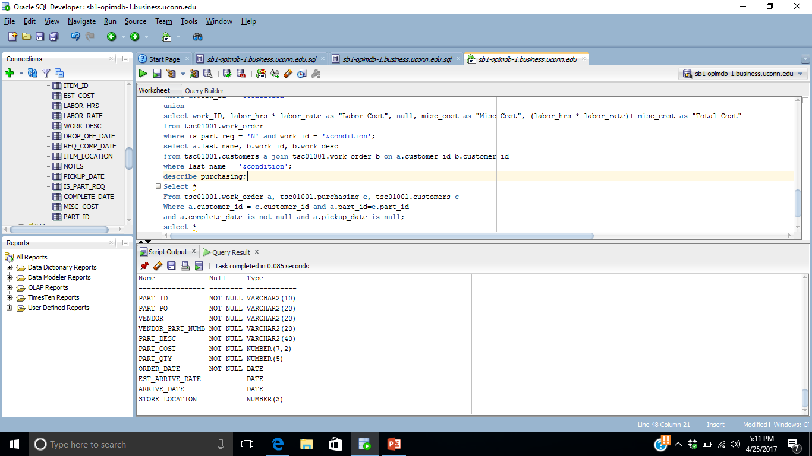
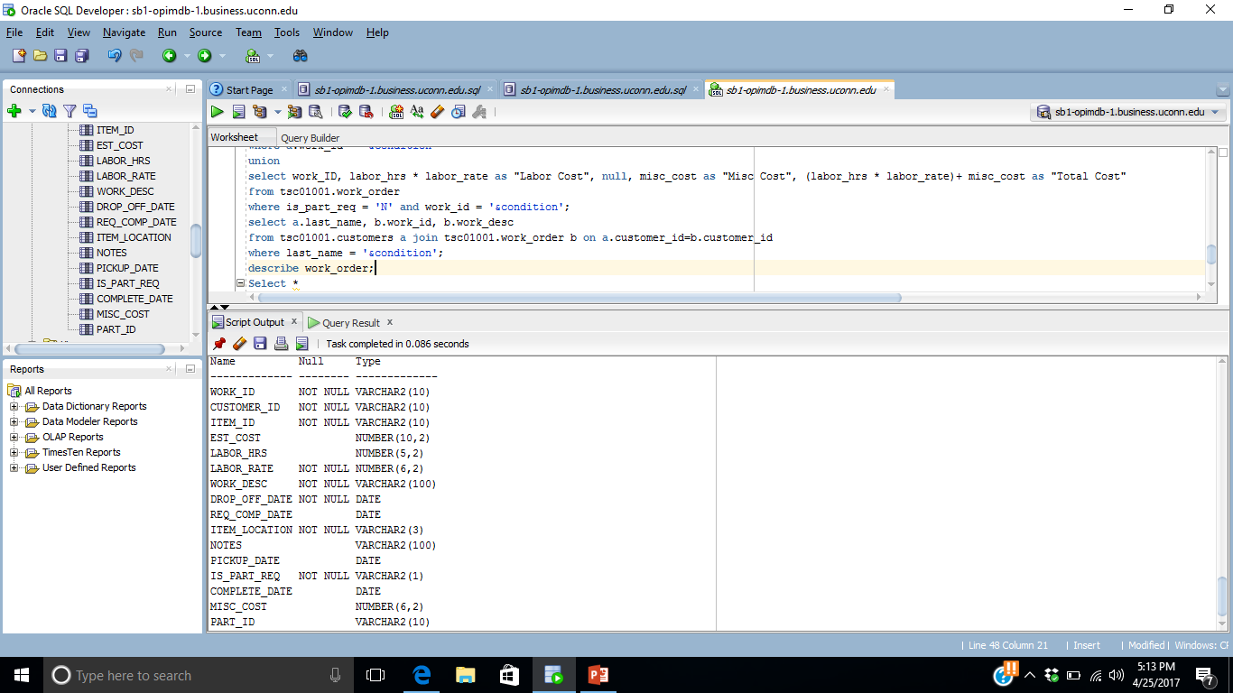
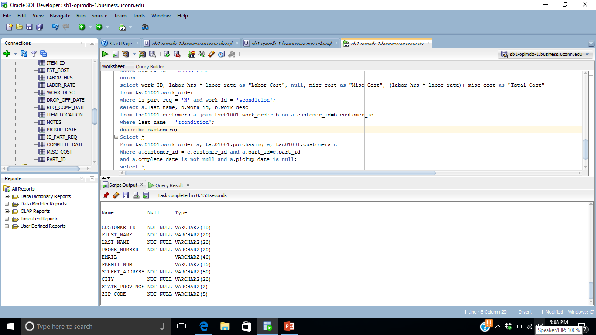
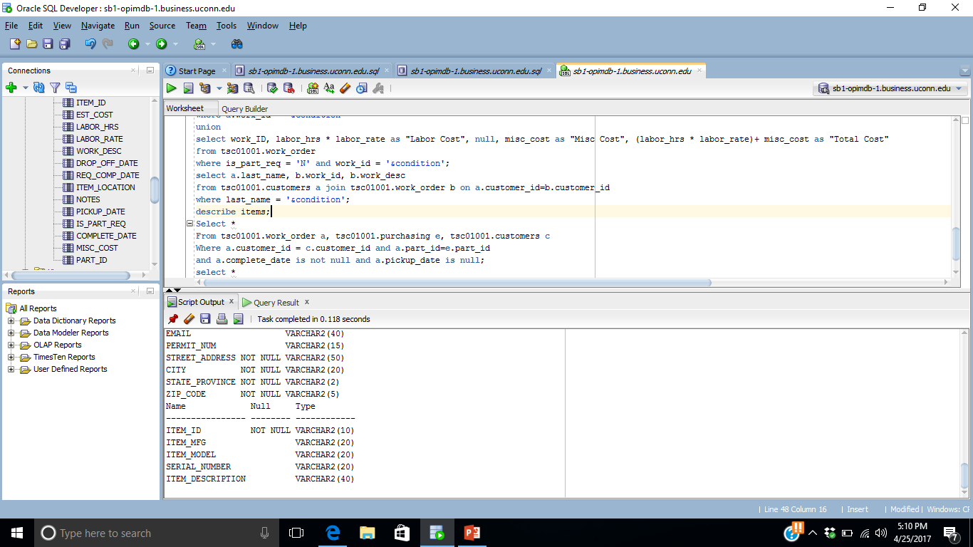
Data Base Tables
Purchasing Table
Customer Table
Item Table
Work Order Table

Slide 12
Queries Requested
Schedule of jobs to be completed where all parts are present or no parts are required order by due date
A list of jobs pending parts delivery by due date
Job search function which could be run to provide customers an update on their specific job
Final bill query which would provide him with a total cost to bill to the customer in his current POS upon pick-up.
A list of completed jobs pending pick-up with the customer information

Slide 13
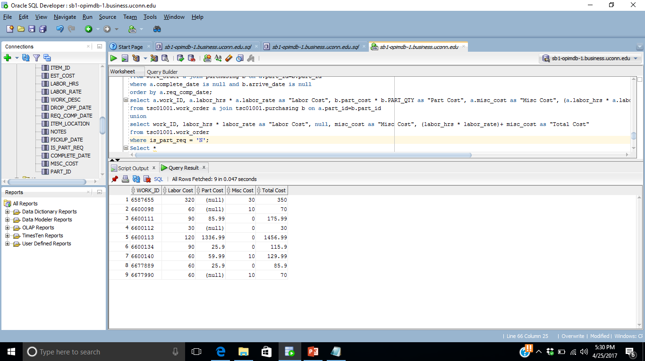
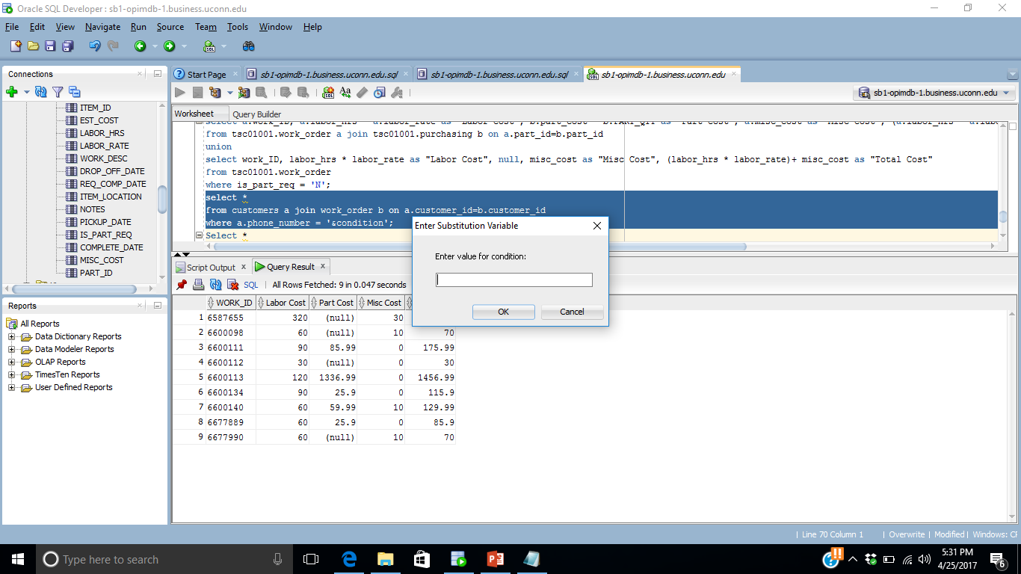
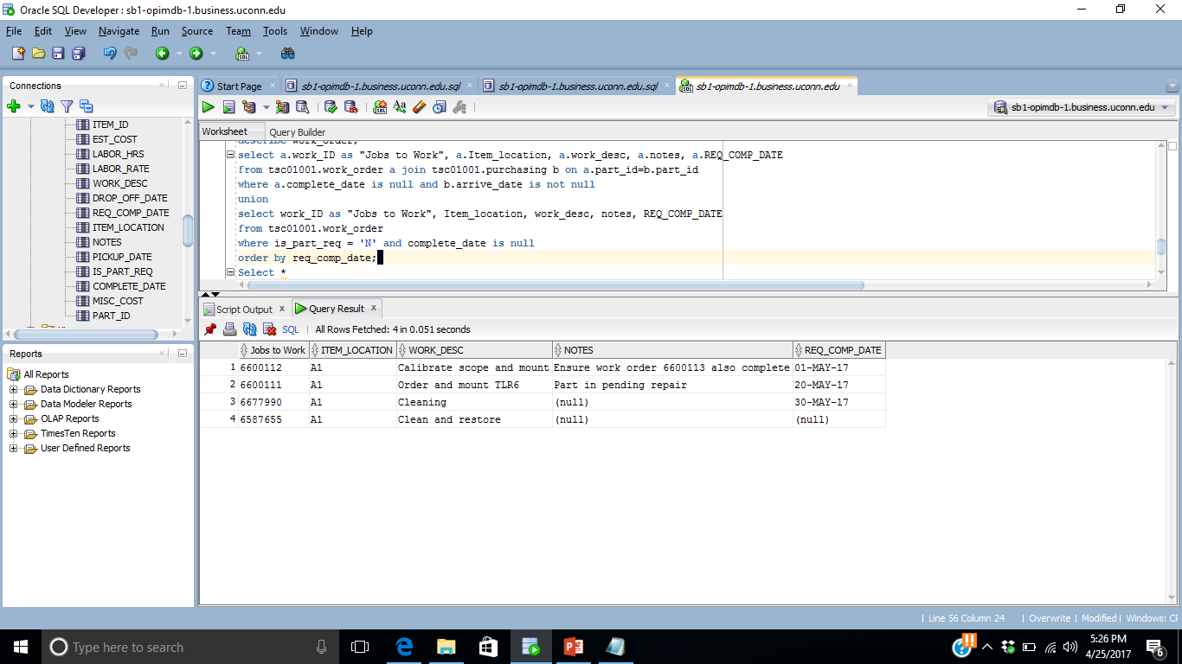
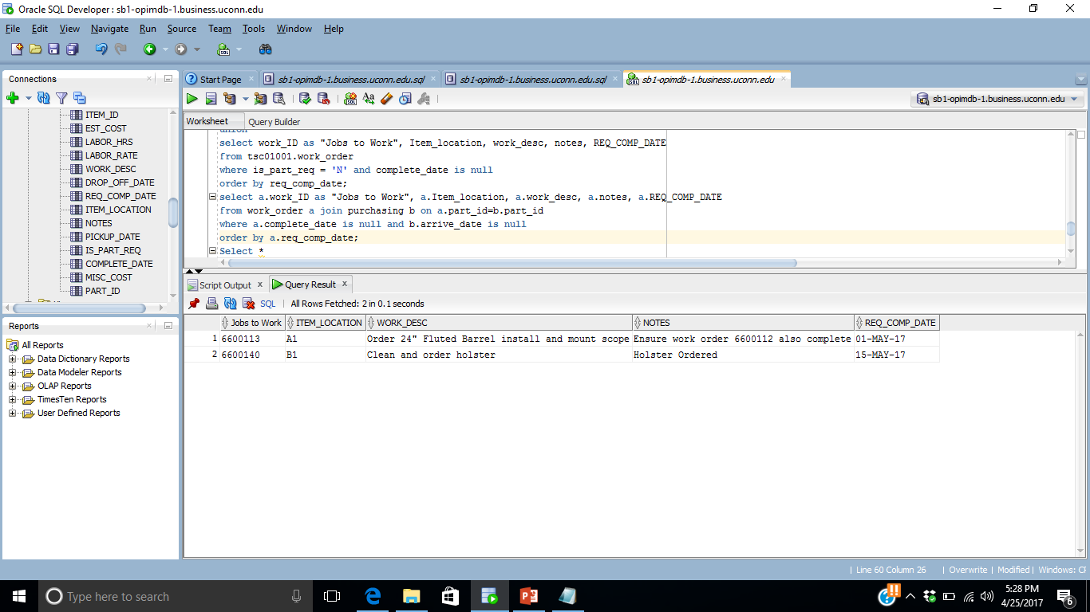
Running Queries

Slide 14
Conclusions
Reduced time loss in maintenance and repairs by using queries for status reports
Improve scheduling for gunsmith by using queries to identify available jobs to work on and priority
Maximize use of space using 5S and One piece flow
Saved 15+ min to provide job status feedback

Slide 15
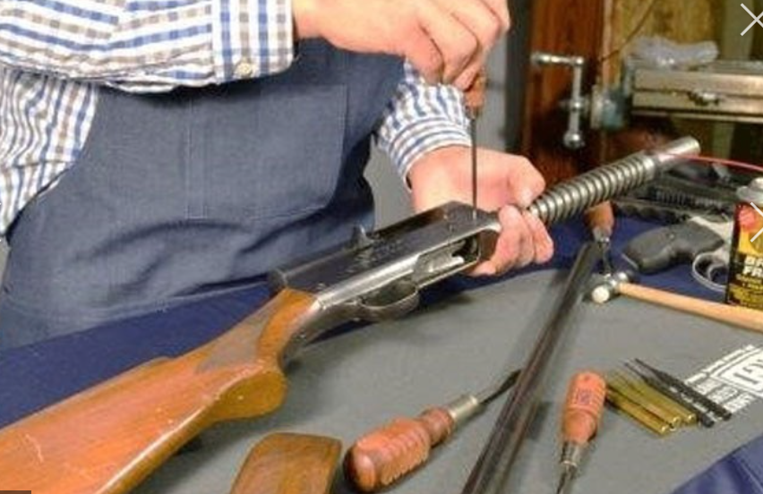
Thank you!
Q&A

